Slide 1
Week 7 Numerical Simulation of Foams Presentation
By Tony Hau

Slide 2
Objective of this presentation section
To explain the ambiguities posed in last week’s presentation, and to explain the difficulties encountered in running the simulation

Slide 3




Main paper reference: https://raw.githubusercontent.com/erleben/FOAM/master/doc/bondorf.17.master_thesis.pdf
Simulation of Two-Dimensional Dry Foam Using a Vertex Model
Main technical reference:
https://cmugraphics.github.io/Scotty3D/meshedit/local/edge_flip Edge Flip Tutorial
https://cmugraphics.github.io/Scotty3D/meshedit/halfedge Half Edge Tutorial
https://www.graphics.rwthaachen.de/software/openmesh/ OpenMesh Library binary
https://www.youtube.com/watch?v=p_OfzxyzM4s
Boost.Python installation tutorial
http://www.haoli.com/cs621ss2019/exercises/exercise1.pdf
CSCI 621: Advanced Digital Geometry Processing Introduction to OpenMesh

Slide 4
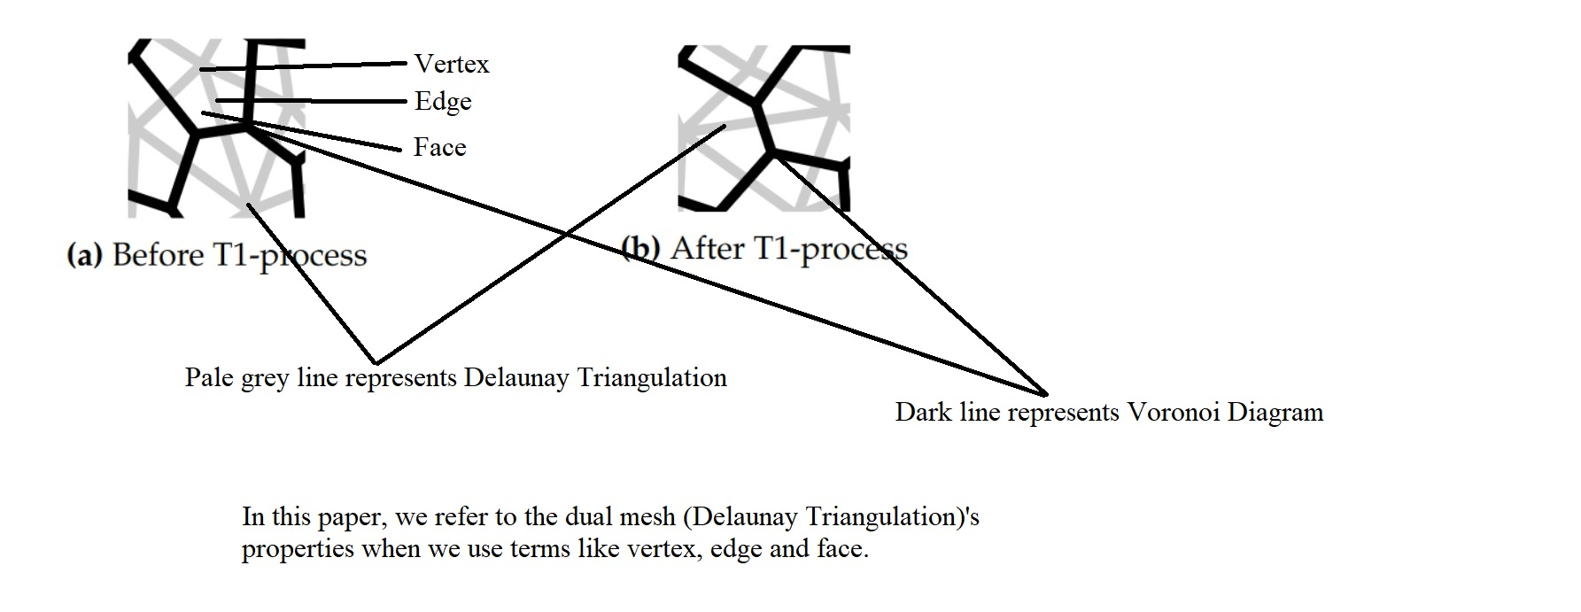
T1 operation – vertex

Slide 5
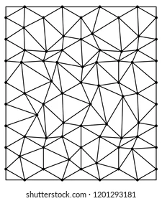
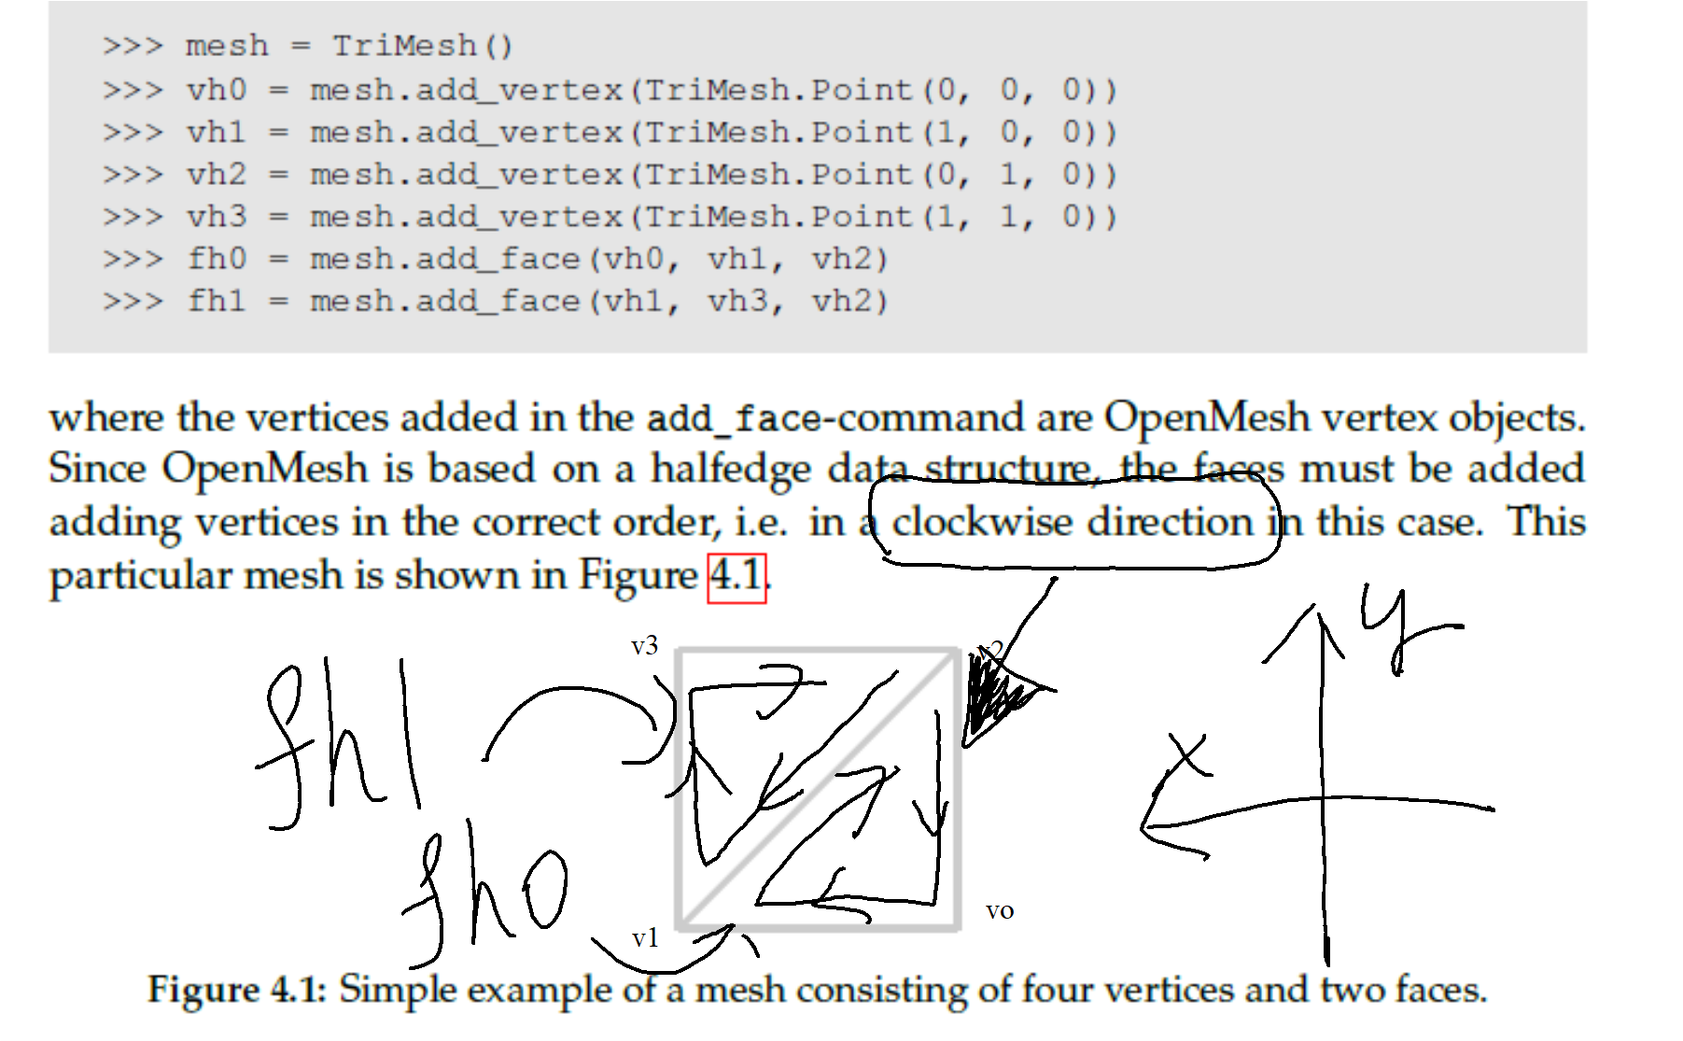

T1 operation – vertex
A triangle mesh
In this simulation (using OpenMesh Library), we represent a triangle mesh (can contain a lot of triangles) using an object : mesh= openmesh.Trimesh()

Slide 6
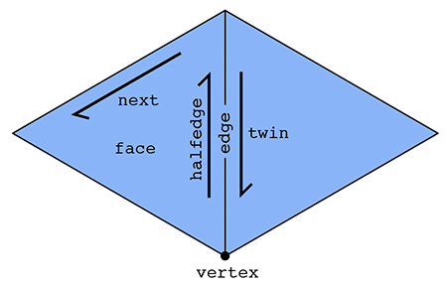
T1 operation – half-edges
The basic idea behind the halfedge is that, in addition to vertices, edges, and faces that make up a mesh, we also have an entity called a halfedge that is directional (like a vector)
Two halfedges are oppositely oriented. Each halfedge knows about the opposite halfedge, which we call its twin. It also knows about the next halfedge around its face, as well as its associated edge, face, and root vertex.
An outgoing halfedge (going out of the vertex)

Slide 7
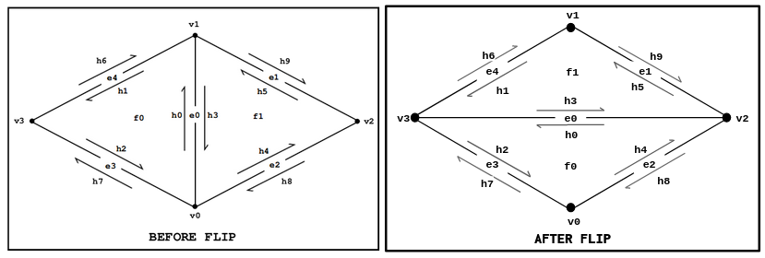
T1 operation – 2 phases of flipping half-edges
Phase 1: Collect elements
Phase 2: Reassign Elements

Slide 8
T1 operation – Phase 1

Slide 9
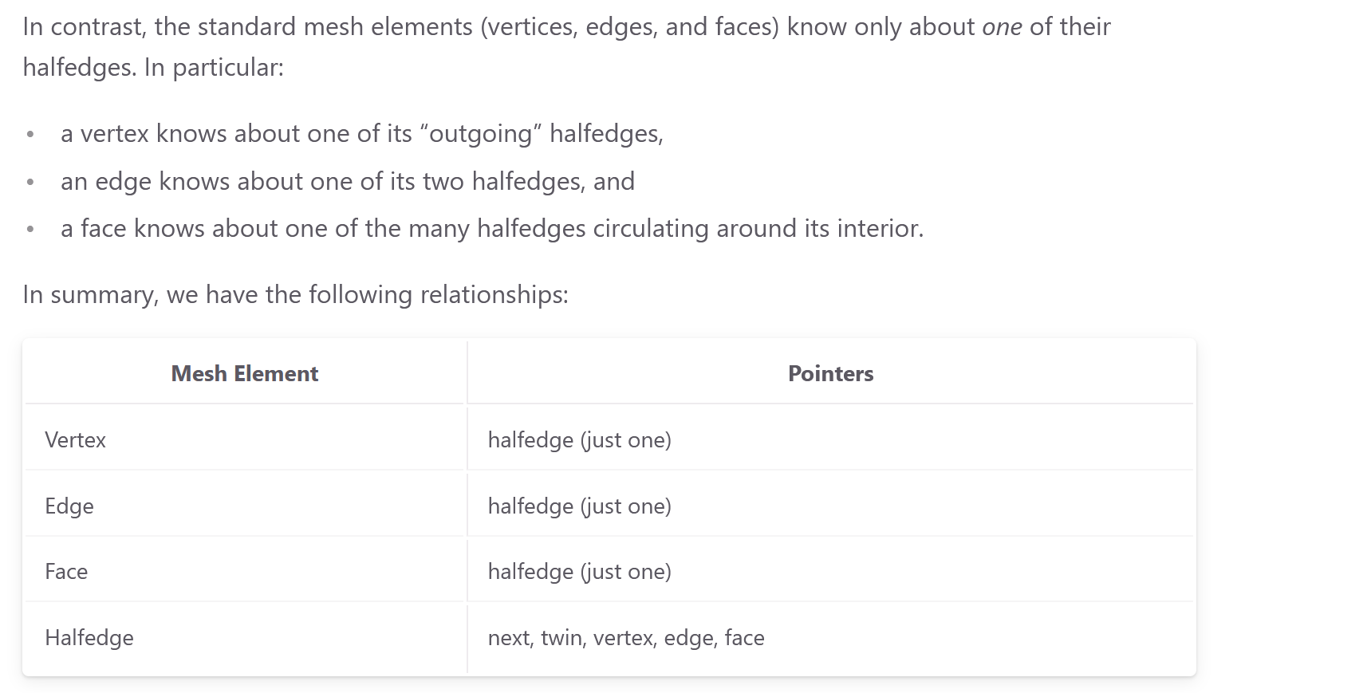
T1 operation – Phase 1
Notes:
I point to a half edge by referring to its affiliated edge

Slide 10
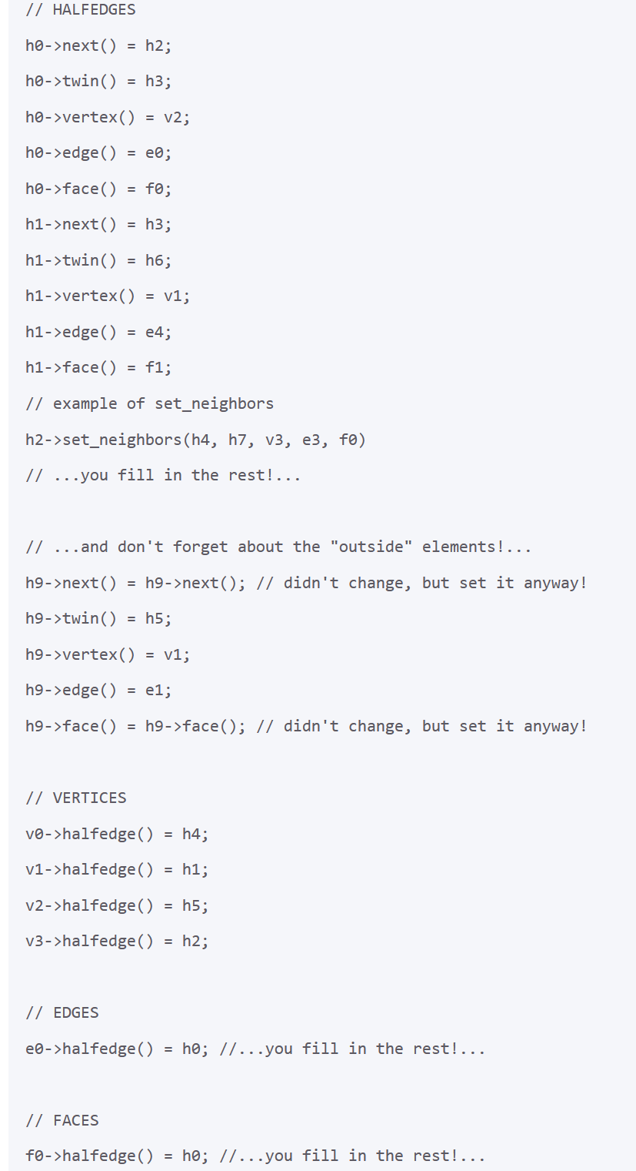
T1 operation – Phase 2
…Next, update the pointers for all the mesh elements that are affected by the edge operation. Be exhaustive! In other words, go ahead and specify every pointer for every element, even if it did not change.

Slide 11
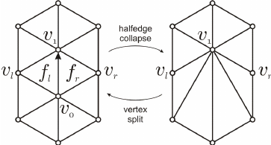
T2 operation – Phase 2
In OpenMesh, T2 is performed by deleting an outgoing half-edge from that vertex.
This half-edge deletion then automatically results in the deletion of three faces and the insertion of one face (two faces).
Assume that v_o’s pointer is the arrowed half-edge above
f_l and f_r are deleted because their pointers are the twins of the arrowed half-edge above

Slide 12
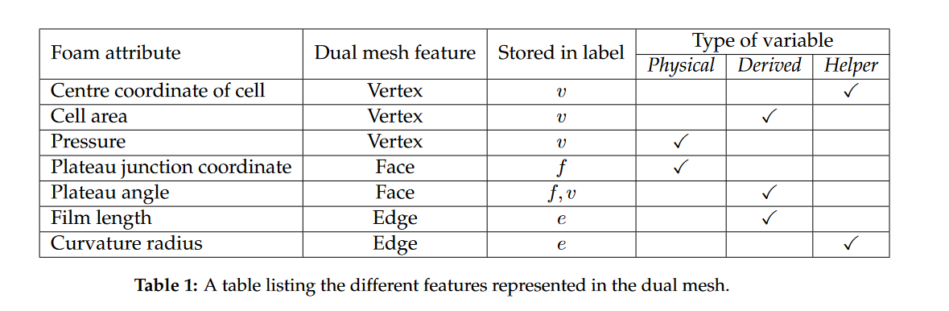
Helper, derived and physical quantities
To simulate Delaunay Triangulation, we only need to process the vertex handler such as vho as shown before, we do not need to know the centre coordinate of cell

Slide 13
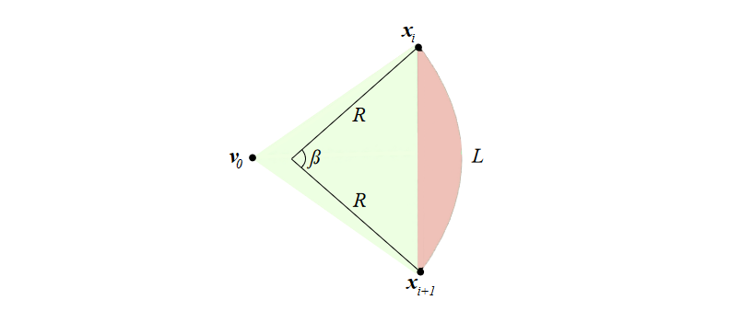
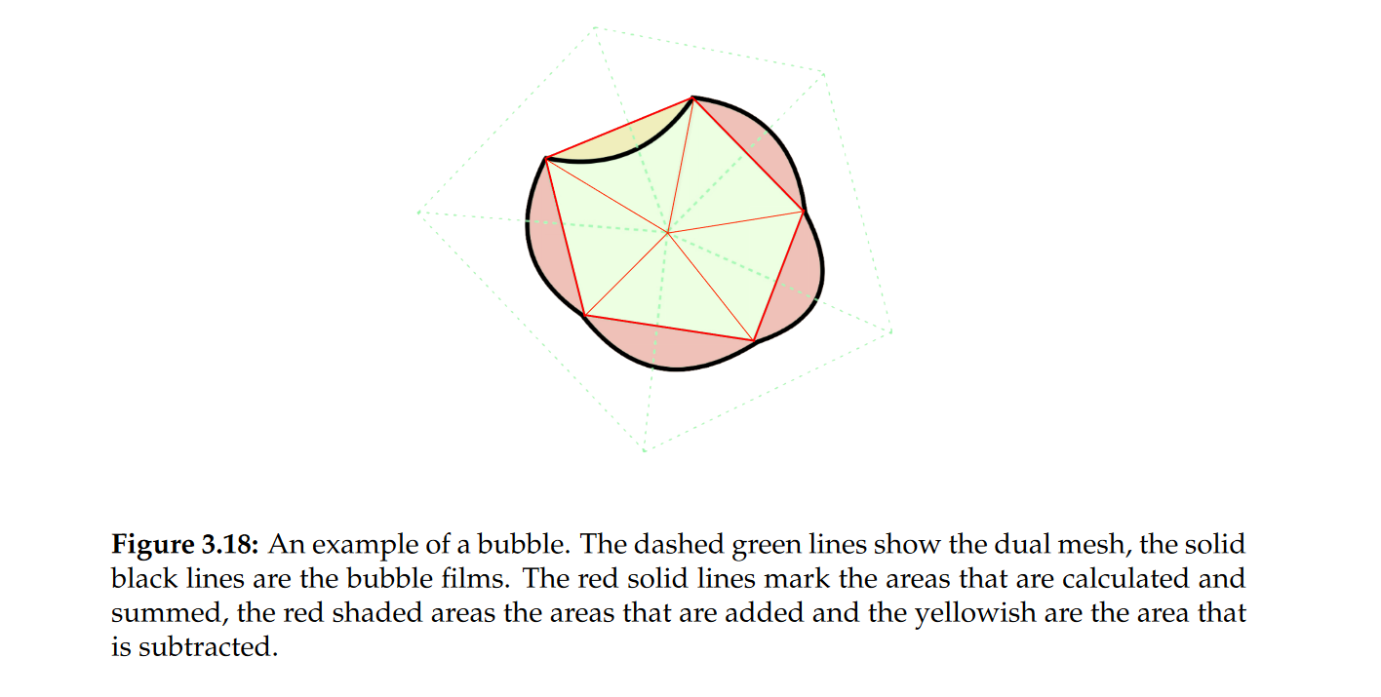
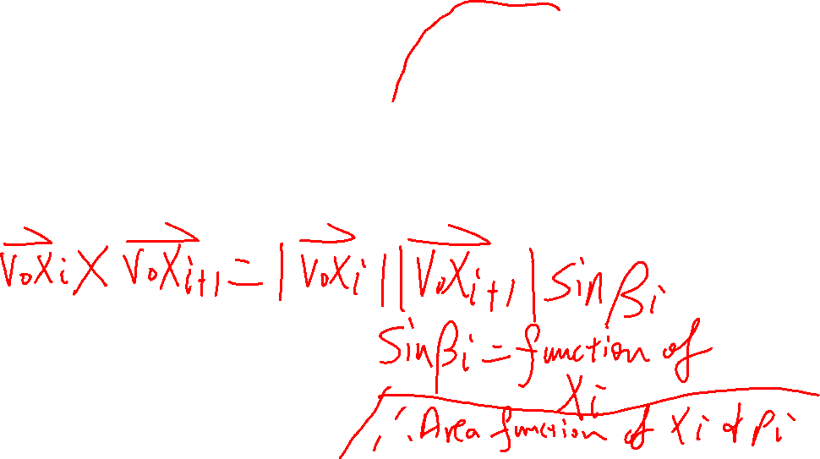
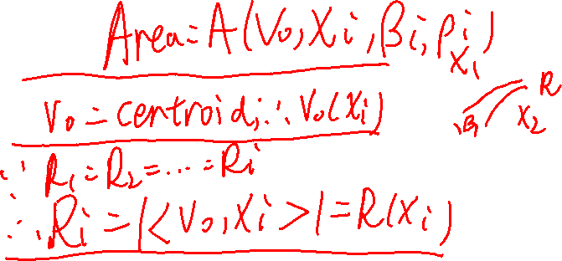
Bubble area – a derived property

Slide 14
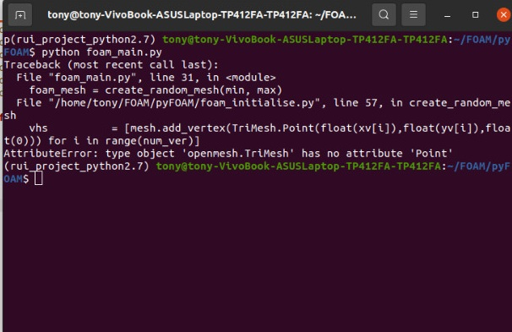
Technical issue encountered
conda install -c conda-forge openmesh-python is a different version of openmesh that is used by the author
Can run film_simulation.py but cannot run film_foam.py because film_simulation.py is a module file, not the main of the whole project
Error message when running foam_main.py using openmesh-python

Slide 15
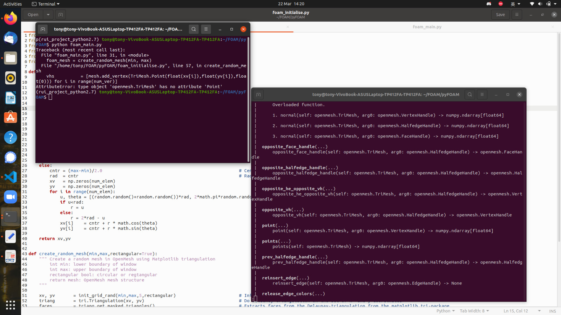
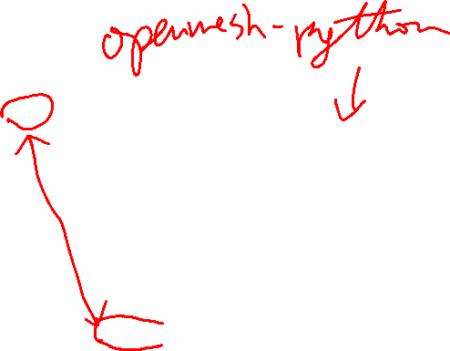
Technical issue encountered
My python version is 3.8. I entered help(openmesh.TriMesh) and find out that openmesh-python uses openmesh.TriMesh.point, not Point as in the author’s code → different version

Slide 16
Technical issue encountered
Only way is to try author’s instruction once more.
The author uses OpenMesh 4.2, should be python 2.7 as well, because his codes include some python 2.7 feature like
print “Hello” instead of print(“Hello”)
Official website for OpenMesh: https://www.graphics.rwth-aachen.de/software/openmesh/download/

Slide 17
Technical issue encountered
There is no OpenMesh 4.2 in the official website so I used OpenMesh 4.1. I downloaded the OpenMesh binary file OpenMesh 4.1 ( tar.gz ) for my linux terminal. Because this is a C++ extension, I need to download Boost.Python to link C++ extension to python → Followed this tutorial for my linux ubuntu
Boost.Python seems not to support python 2 and so I repeated the process with python 3.8 → still cannot install.
https://www.youtube.com/watch?v=p_OfzxyzM4s

